Slide 1
SOLAR APPLICATIONS
ROLLING SHUTTER
COOLER ASSEMBLING
TIN SHED ERECTION
ALL TYPES OF FABRICATIONS
Vedanta Resources
SOLAR APPLICATIONS
SOLAR APPLICATIONS
ROLLING SHUTTER
COOLER ASSEMBLING
TIN SHED ERECTION
ALL TYPES OF FABRICATION
SAFINTEC TECHNOLOGIES
PASSION TO DELIVER THE EXCELLENCE
EE-11, SUPER CITY, GYANSHEELA SOCIETY, DHABLI , INDORE - 453771
MSME REG.NO : UDYAM-MP-23-0003621 GUMASTA REG.NO :--------------- GSTIN : XX XXXXXXXXXX X X X CONTACT NO : 8181910109

Slide 2
SOLAR APPLICATIONS
ALL TYPES OF FABRICATION
NAZAARA ENTERPRISE
ROLLING SHUTTER
AUTO BODY BUILDING
PASSION TO DELIVER THE EXCELLENCE
COOLER ASSEMBLING
VERTICAL WALL PRINTING
EE-11, SUPER CITY, GYANSHEELA SOCIETY, DHABLI , INDORE - 453771
TIN SHED ERECTION
CHAIN LINK FENCING
MSME REG.NO : UDYAM-MP-23-0003621 GUMASTA REG.NO :--------------- GSTIN : XX XXXXXXXXXX X X X CONTACT NO : 8181910109

Slide 3
NAZARA ENTERPRISE
PASSION TO DELIVER THE EXCELLENCE
EE-11, SUPER CITY, GYANSHEELA SOCIETY, DHABLI , INDORE - 452001
MSME REG.NO : UDYAM-MP-23-0003621 GUMASTA REG.NO :--------------- GSTIN : XX XXXXXXXXXX X X X CONTACT NO : 8181910109

Slide 4
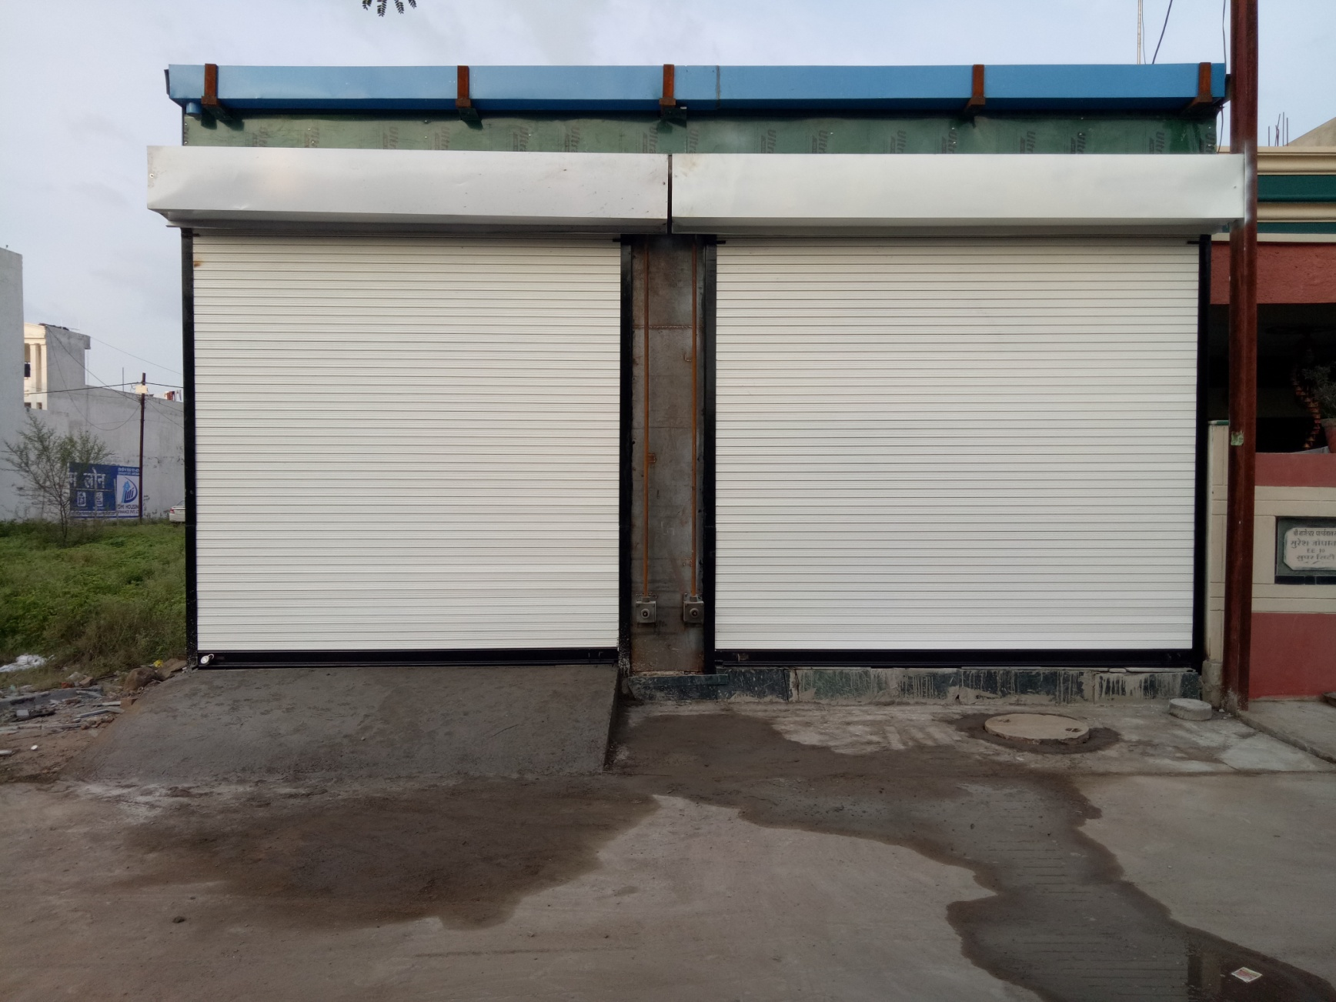
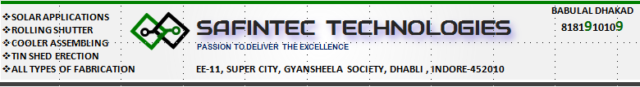

Slide 5
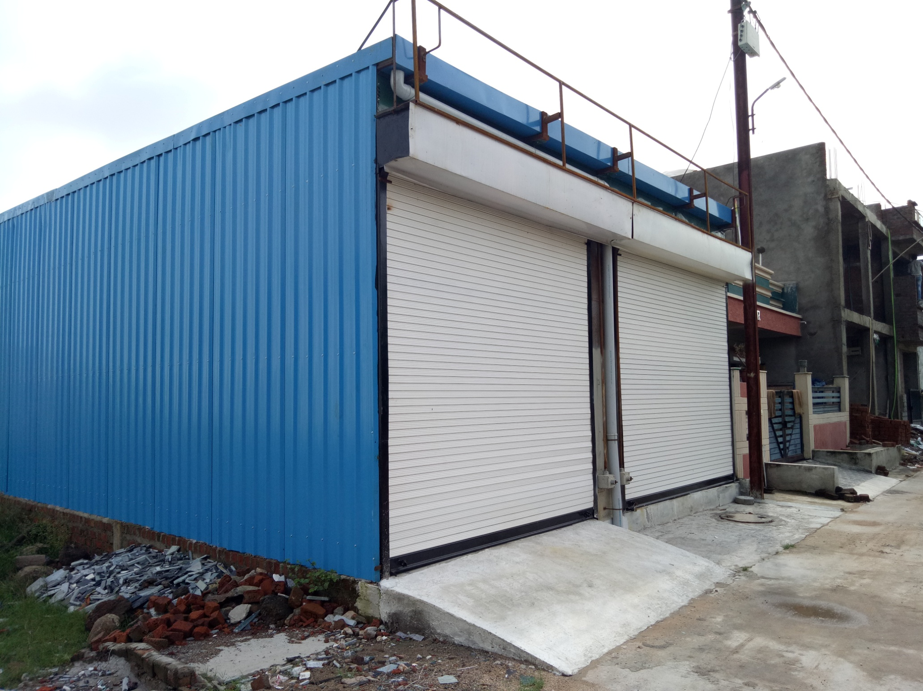

Slide 6
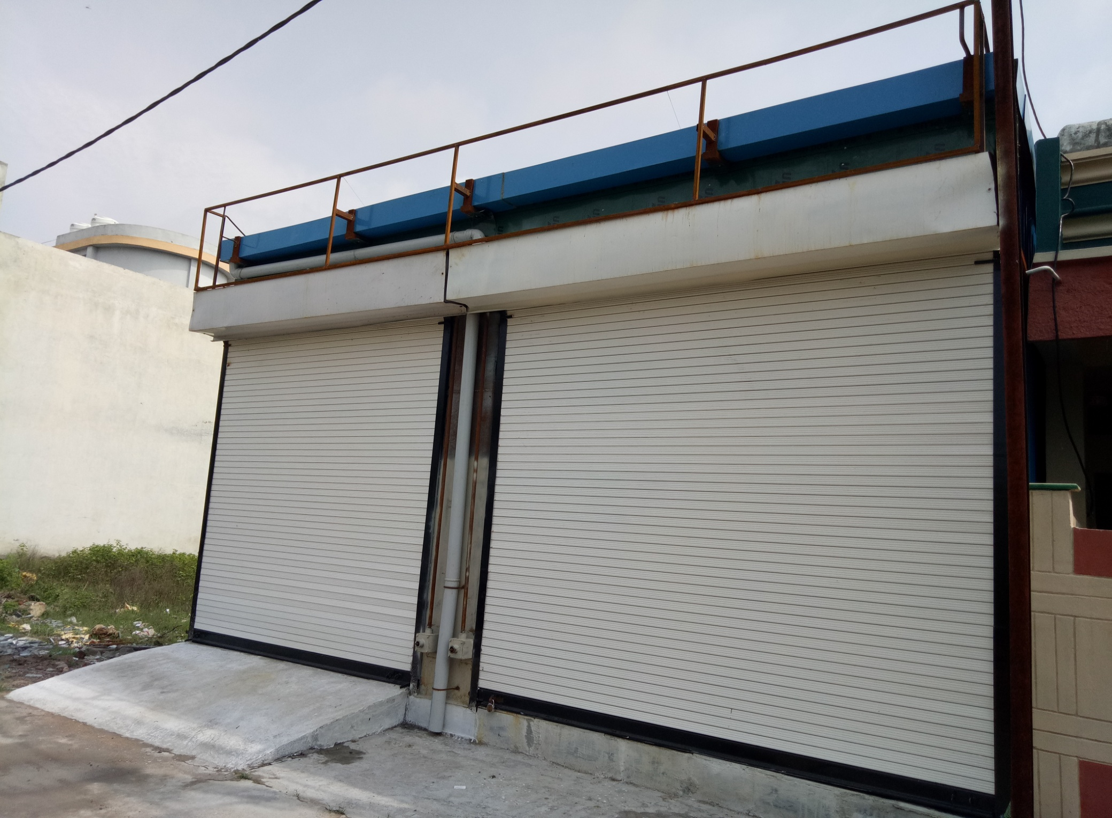

Slide 7
NAZARA ENERPRISES
PASSION TO DELIVER THE EXCELLENCE
EE-11, SUPER CITY, GYANSHEELA SOCIETY, DHABLI , INDORE - 453771
MSME REG.NO : UDYAM-MP-23-0003621 GUMASTA REG.NO :--------------- GSTIN : XX XXXXXXXXXX X X X CONTACT NO : 8181910109

Slide 8

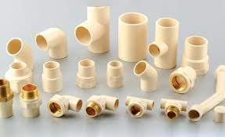

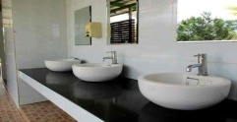


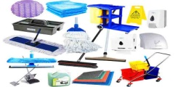

HARDWARE
SANITARY WARES
PLUMBING MATERIALS
PAINT AND ADHESIVES
ELECRICAL ACCESSORIES
AGRICULTURE TOOLS
HOUSEKEEPING MATERIALS
FABRICATION MATERIALS
SHOP OPEN/CLOSE TIME : 0800-2000 HRS
WEBSITE : NAZAARA.CO.IN
Nazara Enterprises
PASSION TO DELIVER THE EXCELLENCE
EE-11, SUPER CITY, GYANSHEELA SOCIETY, DHABLI , INDORE - 453771
MSME REG.NO : UDYAM-MP-23-0003621 GUMASTA REG.NO :--------- GSTIN : XX XXXXXXXXXXXXX CONTACT NO : 8181910109

Slide 9
HARDWARE
SANITARY WARES
PLUMBING MATERIALS
PAINT AND ADHESIVES
ELECRICAL ACCESSORIES
AGRICULTURE TOOLS
HOUSEKEEPING MATERIALS
FABRICATION MATERIALS
SHOP OPEN/CLOSE TIME : 0800-2000 HRS
WEBSITE : NAZAARA.CO.IN
NAZARA ENTERPRISES
PASSION TO DELIVER THE EXCELLENCE
EE-11, SUPER CITY, GYANSHEELA SOCIETY, DHABLI , INDORE - 453771
MSME REG.NO : UDYAM-MP-23-0003621 GUMASTA REG.NO :--------- GSTIN : XX XXXXXXXXXXXXX CONTACT NO : 8181910109

Slide 10




